Slide 1
AFINet 5th International Conference 2024
(online)
AFINet 5th International Conference 2024
(online)

Slide 2
Transgenerational transmission model of the addiction problem: A clinical case report
Cassandra Borges Bortolon
Clinic Psychologist, Family and Couple Therapist, Specialist, MSc, Health Science PhD
AFINet Trustee

Slide 3
Transgenerationality
It consists of processes transmitted from one generation to another that is repeated through family patterns, in spite of the family members not realizing it.
It is characterized by legacy, values, behaviours, believes, secrets, rites and myths.
The transgenerationality remains present throughout the family’s history.

Slide 4
The Therapeutic Process
Psychotherapy for 9 months
Weekly
Psychiatrist treatment for 3 years
Medications: Bupropion, Naltrexone and Lamotrigine.

Slide 5
Cleber a clinical case report
Divorced
46 years old
Business Administrator

Slide 6
“On the razor´s edge”
Cleber describes himself and his family as living “On the razor´s edge”
What does it mean? Under pressure and putting himself at risk.
Related to alcohol abuse, hypersexual behaviour and other behaviours that compromise his safety.

Slide 7
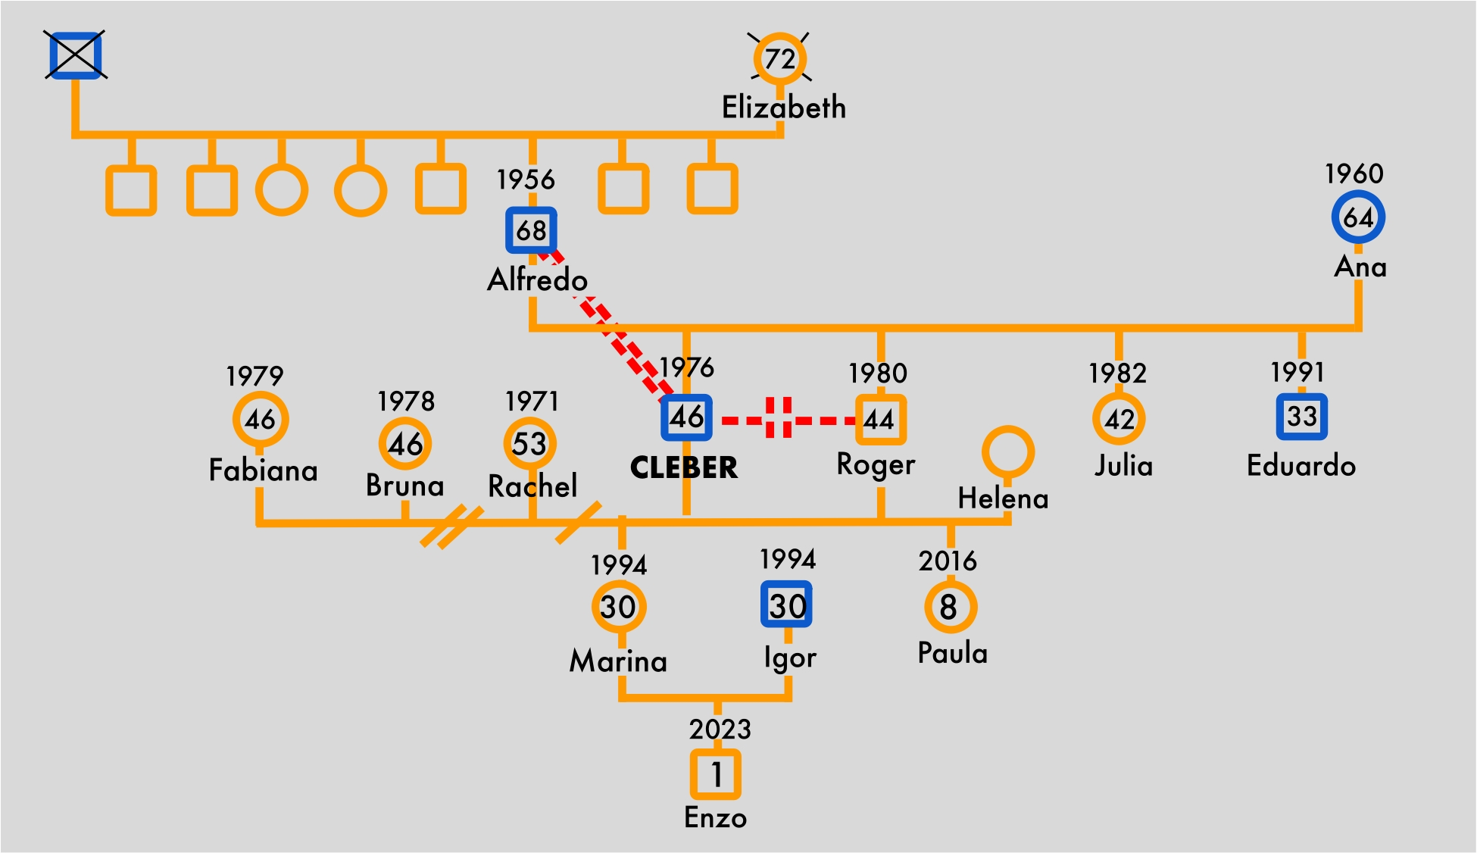
Soares' Genogram
Subtitle:
- Blue box: abusive alcohol intake
- Red lines linking Alfredo and Cleber:
Troubled relationship
- Dotted red line linking Cleber and Roger: Broken relationship

Slide 8
1976
Soares Family
Timeline
“On the razor´s edge”
Almost fifty years of history
Almost fifty years of history
2024
End of AGO

Slide 9
Soares Family Timeline 1/4
1976
1978
1978
Soares Family
Timeline
“On the razor´s edge”
Parents met - Alfredo and Ana
First child Cleber´s birth
Parents Marriage
1990
1986
1982
1980
Father´s hyperactive sexual behaviour
Father Alfredo´s abusive alcohol intake
Third child Julia´s birth
Second child Roger´s birth
Cleber´s daughter - Marina. Cleber had a relationship with a colleague Rachel on his first job. He had his first sexual relationship in which she got pregnant
1991
1987
1993
1994
Whole family moved between rural towns
Fourth child Eduardo´s birth

Slide 10
2001
2001
Soares Family Timeline 2/4
2004
2004
Alfredo started a company under Cleber´s name which Alfredo administered
Cleber´s abusive alcohol intake
Cleber and Bruna´s marriage
Cleber´s hyperactive sexual behaviour
2016
2012
2010
Cleber´s company, administered by his father, had fiscal problems that compromised Cleber´s savings, that took 10 years to resolve
Cleber's mother Ana begins intensive alcohol intake and continues until the present day
Cleber Divorced Bruna
2017
Alfredo´s accident - He fell from the second floor of a prostitution establishment that resulted in severe immediate and long term damages: Dementia
2018
Eduardo´s abusive alcohol intake

Slide 11
2019
Soares Family Timeline 3/4
2020
Cleber takes his father in to live with him. He organises an apartment on the first floor of his house
Cleber´s parents divorced. Cleber´s parents didn't have a good relationship for a long time. Even as children their sons didn´t accept the father's behaviour toward the mother
2023
2022
2021
Cleber is diagnosed by a psychiatrist with Bipolar Disorder
Cleber begins dating Fabiana. 2024 she is diagnosed with Depression
Cleber’s grandson Enzo is born. Marina married a man, Igor, that consumes alcohol abusively
Fabiana makes contact to learn more about Substance Use Disorder (SUD) treatment and to schedule an appointment to Cleber with the psychotherapist
2023
2023
OCT
SET
Cleber begins specialized treatment for SUD

Slide 12
2024
Soares Family Timeline 4/4
2023
OCT
MAR
2024
APR / JUN
Cleber showed improvements in his consciousness about the transgenerational model and using tools to deal with addiction problems
Cleber stops drinking for 3 months. After this period he restarts drinking
2024
AGO
2024
JUL / SEP
2024
MAY
Cleber was impacted directly by Southern Brazil’s floods. The entire first floor of his house was flooded
Fabiana contacts the psychotherapist to report Cleber´s abusive alcohol intake
Cleber´s behaviour “On the razor’s edge”
Cleber intensified his abusive alcohol intake, betraying his girlfriend, got into financial trouble at the same prostitution establishment where Alfredo´s accident happened
2024
End of AGO

Slide 13
Moving Forward
Supporting Cleber to return and maintain his learning process (behaviours, thoughts, actions and family relations) within a "virtuous circle": quit drinking, have a healthier relationship with his girlfriend, and continue good performance in his job.
Continuing Cleber's psychotherapy with Systemic Therapy to explore more connections among individual, familiar and social aspects.

Slide 14
Moving Forward
Regardless, Cleber has acquired more knowledge and comprehension about his family legacy in a transgenerational transmission model of the addiction problem: alcohol intake and hyperactive sexual behaviour.
Finally, it is important to stimulate all of Cleber's FMs to engage in specialized treatment for addiction problems.

Slide 15
References
Falcke, D. & Wagner, A (2005). A dinâmica familiar e o fenômeno da transgeracionalidade: definição de conceitos. In: A. Wagner, Como se perpetua a família: A transmissão dos modelos familiares. Porto Alegre: EDIPUCRS p.25-46.
Camicia, E.G, da Silva, SB. Schmidt, B (2016). Abordagem da Transgeracionalidade na Terapia Sistêmica Individual: Um Estudo de Caso Clínico. Pensando famílias. Porto Alegre: (20).1 p.68-82.

Slide 16
Thank you very much
Contact:
cassandra@acurarte.com.br
+55 51 981394719
Av. Osvaldo Aranha 440-404
Porto Alegre, Rio Grande do Sul
Zip Code 90.035-190 - Brazil

